Slide 1

A Multifactor Security Protocol for Wireless Payment-Secure Web Authentication using Mobile Devices

Slide 2
TEAM MEMBERS
ID NO | NAME
170030193 | CHALLA VENKATA PRANITH
170030614 | KOLLI SAI KIRAN
170031068 | PULIVARTHI GOUTHAM
170031340 | VALIVETI LOHYA SUJITH

Slide 3

OUTLINE
1.Abstract
2.Literature survey
3.Problem statement
4.Objectives

Slide 4
Abstract
The Cell phones have revolutionized the way we live. Cellular phones and PDA's have largely grown in popularity and as a result users have started online banking, purchasing of internet-based products and other online services. Previous web access authentication systems have used either the Internet or the wireless Mobile channel independently to authenticate the identity of remote user. Accessing today's web-based services always requires a username and password to authenticate the user identity. This is a significant vulnerability since the password can be hacked by the man in the middle attack and later used for making illegal access to the user’s account.

Slide 5
Our goal is to create an authentication system that is both secure and highly usable based on multifactor authentication approach. It uses a novel approach to create an authentication system based on TICs (Transaction Identification code) and SMS (Short Message Service) to enforce an extra security level with the traditional Login/password system. We have also used an encryption/decryption technique which is based on symmetric key and an iterated block cipher concept. This concept has been used to keep TICs as secret code on cell phones/PDAs and is also used to initiate secure web transaction using cell phones/PDAs. Finally we extend the system for two-way authentication which authenticates both parties (user and e- service provider). A detailed threat analysis demonstrates that the proposed system is secure against various types of internet attacks like phishing, man-in-the-middle, viruses etc.

Slide 6
LITERATURE SURVEY FOR MODULE-1
Single-factor authentication is the simplest form of authentication methods. With SFA, a person matches one credential to verify himself or herself online. The most popular example of this would be a password (credential) to a username. Most verification today uses this type of authentication method.
Two-factor authentication uses the same password/username combination, but with the addition of being asked to verify who a person is by using something only he or she owns, such as a mobile device. Putting it simply: it uses two factors to confirm an identity

Slide 7
Multi-factor Authentication uses a combination of the following factors: something you know, something you have and something you are. 2FA is a subset of MFA.
Multi-factor authentication methods are difficult to compromise than single-factor methods. Let us take for example, the use of a logon ID/password is single-factor authentication (i.e., something the user knows); whereas, an ATM transaction requires multifactor authentication: something the user possesses (i.e., the card) combined with something the user knows (i.e., PIN). “Out-of-band” controls for risk mitigation can also be included in multifactor authentication methodology. An effective authentication method should have customer acceptance, reliable performance, scalability to accommodate growth, and interoperability with existing systems and future plans

Slide 8
LITERATURE SURVEY FOR MODULE-2
As days are passing online payments is getting popular and for this people uses various modes of payment like Debit card, Credit Card, electronic wallet, e-banking etc. People purchase products over the internet and also pay the bill online, which is easy to implement and also saves the time. But the only question that comes in the mind of every person is about the security of data which has been shared by the person while online payment
When it comes to the communication of sensitive data security has always been an important topic. With hardware advances allowing users the advantage of accessibility used in mobile devices, individuals are now spending more and more time on these devices. Additionally, with the viral popularity of social media applications and single sign-on, users do not always take as many precautions as needed with their information. Multi-factor authentication creates more and varied walls to block out the wrong people from seeing your information

Slide 9
The server can preserve all records for auditing purposes, but security is enhanced because the merchant never gets direct access to the customer's financial account information.
we consider 4 phases in the transaction flow of the system as follows,
1. Firstly, the basic login i.e validating the credentials of user/payer
2. Performing of Two factor authentication
3. Now validating of the Transaction Identification Code (TIC).
4. SMS Confirmation.
Encryption algorithm plays very important role in communication security, On a survey the performance of existing encryption techniques like AES, DES and RSA algorithms is as follows ,Based on the text files used and the experimental result it was concluded that AES algorithm consumes least encryption and RSA consume longest encryption time . From the simulation result, we evaluated that AES algorithm is much better than DES and RSA algorithm.

Slide 10
LITERATURE SURVEY FOR MODULE-3
Phishing is a cybercrime in which a target or targets are contacted by email, telephone or text message by someone posing as a legitimate institution to lure individuals into providing sensitive data such as personally identifiable information, banking and credit card details, and passwords.
User Session Hijacking:
Session Hijacking is an attack which is basically used to gain the unauthorized access between an authorized session connections. This is usually done to attack the social network website and banking websites in order to gain the access over the valid session as well as over the website too.

Slide 11
Virus Attack on Cell Phones & PDAs: Most current cell phones have the ability to send and receive text messages. Some cell phones and PDAs also offer the ability to connect to the Internet. Although these are features that you might find useful and convenient, attackers may try to take advantage of them.
abuse your service.
lure you to a malicious web site.
use your cell phone or PDA in an attack.
gain access to account information.
PREVENTION:
Apply available critical patches and upgrades to the operating system
Eliminate or disable unnecessary services and applications
Install and configure additional applications that are needed
Configure user authentication and access controls

Slide 12
TECHNOLOGIES:
J2ME Toolkit Features:
Support for obfuscation in the build cycle.
Method profiling.
JDK Security Features types:
Users running programs.
Developers
Systems administrators, developers, and users.
JDBC:
The Java Database Connectivity (JDBC) specification is a new basis for developers to interface with data sources.
ORACLE 9i with J Server:
Oracle9i Application Server provides the lowest total cost of ownership of any application server on the market, by delivering the most comprehensive, standards-based functionality from a single fully integrated e-Business platform.

Slide 13
LITERATURE SURVEY FOR MODULE-4
Authentication of the user to the Bank authentication Server based on user login/password:
authentication has three tasks:
Manage the connection between the human (user) and the website’s server (computer).
Verify users’ identities.
Approve (or decline) the authentication so the system can move to authorizing the user.

Slide 14
Password-Based User Authentication Methods:
A password-based user authentication process generally looks like this:
When you land on the page, you’ll be asked to enter your username and password.
Your credentials are sent to the website’s server and compared with the information they have on file.
When a match is found, you’ll be able to enter your account.
TIC AUTHENTICATION:
TIC Authentication is the technique which is used to identify both the user and the ongoing transaction.

Slide 15
SMS AUTHENTICATION:
Another method to validate user transaction is an SMS confirmation. Financial institution stores user cell phone number to provide multifactor authentication. It is believed that users will carry cell phone and can receive/send the short message.
SMS CONFIRMATION:
After the TIC code identification and validation the remainder of the transaction will proceed. At the end of the transaction the user will get an SMS from the web authentication server to confirm financial transaction. Security of the proposed system will also depend on the security of encrypted messages sent by SMS and algorithm used for message encryption.

Slide 16
According to the Mobile Payment Forum, mobile payments are the transactions with a monetary value that is conducted through a mobile telecommunications network through diverse mobile users' devices, such as cellular telephones, smart phones or PDAs, and mobile terminals. Mobile payment is a transfer of funds in return for goods or services in which a mobile device is functionally involved in executing and confirming payment. The payer can be standing at a POS or be interacting with a merchant located somewhere else. Mobile payment systems enable customers to purchase and pay for goods or services via mobile phones. Here, each mobile phone is used as the personal payment tool in connection with the remote sales. Payments can take place far away from both the recipient and the bank

Slide 17
PROBLEM STATEMENTS
The user’s secret information required to access the online systems is stolen through Phishing attacks, key-loggers and spyware.
Attacker oversees the dynamic client meeting and screens all client exercises. In this attack all client's online exercises are checked utilizing malicious softwares (malwares).For Session hijacking. It can run on a user’s local computer, or remotely as a attack like “man-in-the-middle” attack.

Slide 18
OBJECTIVES
The fundamental goal of the current work is to give an exceptionally secure remote climate for monetary web exchanges that is easy to utilize and convey, that doesn't require any change in existing remote organizations or convention.This Protocol for wireless payment is used to achieve secure web transaction using cell phones / PDAs. This framework depends on Multi-Factor Verification idea to give secure remote climate to the clients to expand confidence of the clients in online monetary web exchanges utilizing portable gadgets(Mobile Phones).

Slide 19
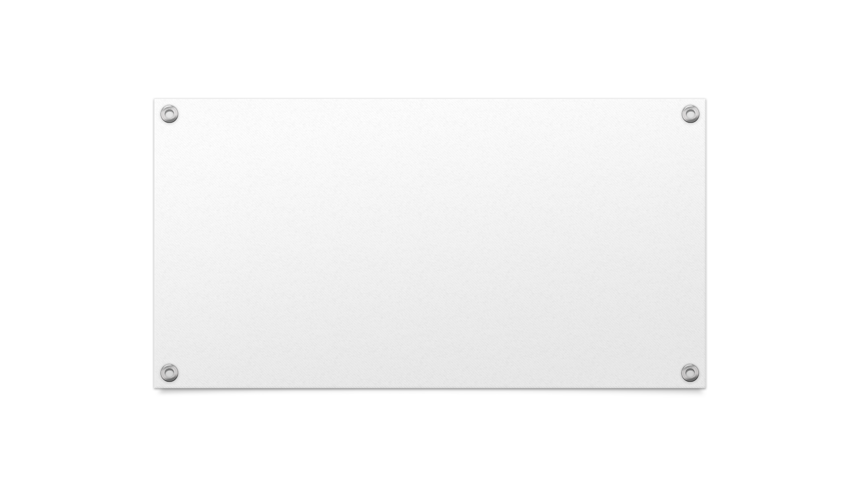
THANK YOU

